Slide 1


Slide 2

Rev. Dr. Glenn Barth
President

Slide 4
Wes Furlong
MA, MSW, PhD candidate (Baylor University)
Research Director

Slide 5
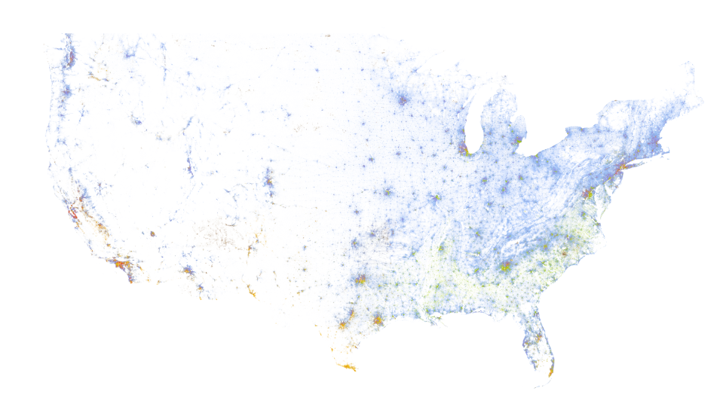
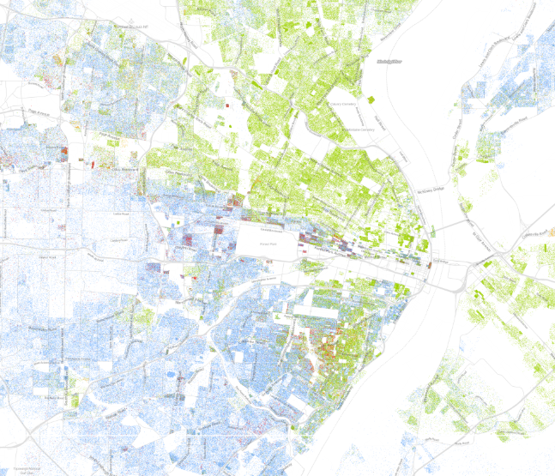
The Use of Data in Conversations on the Story of Racial Inequality

Slide 6
What we’ll cover
Data trends related to structural racism.
Conceptualize and measure segregation.
Groundwater metaphor to explain “structural racism.”
Data on the myths about the racial wealth gap.
Slides & data are available at: github.com/jwesleyfurlong/wealthtrends

Slide 7
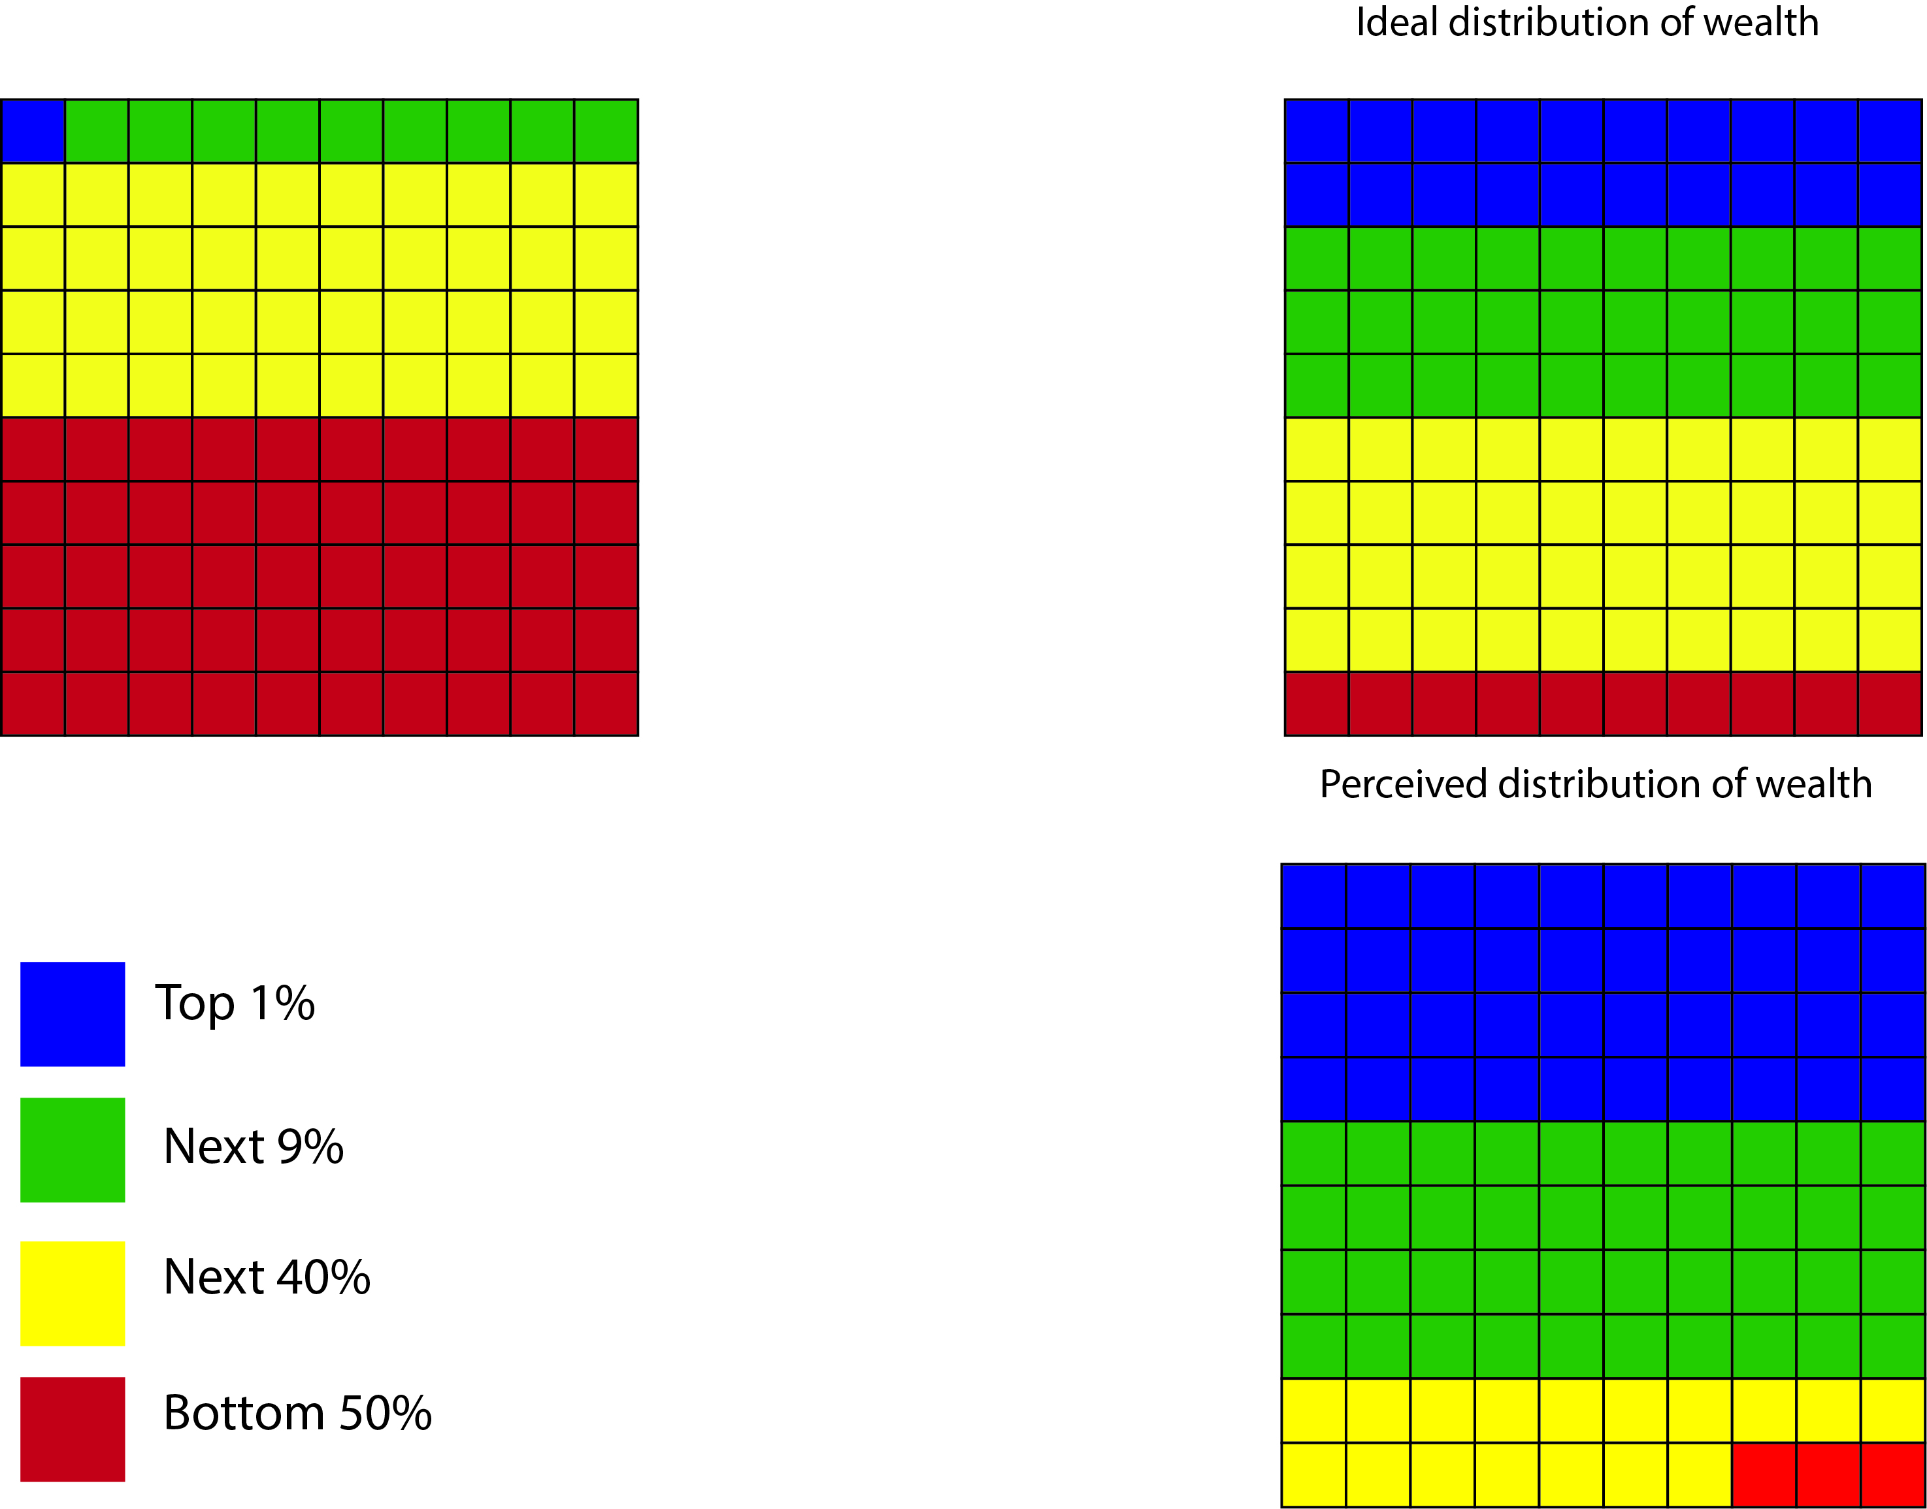
Percent of population

Slide 8
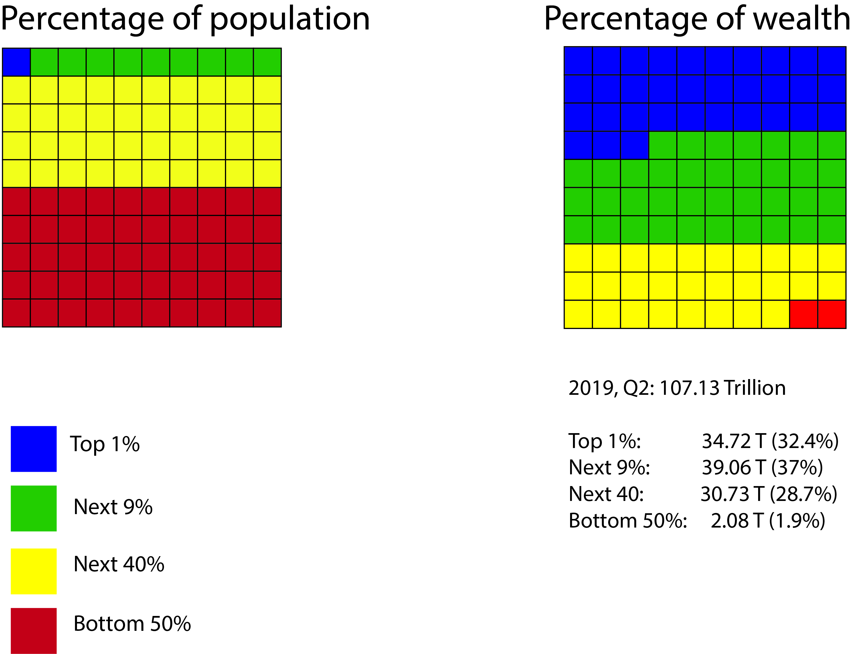

Slide 9
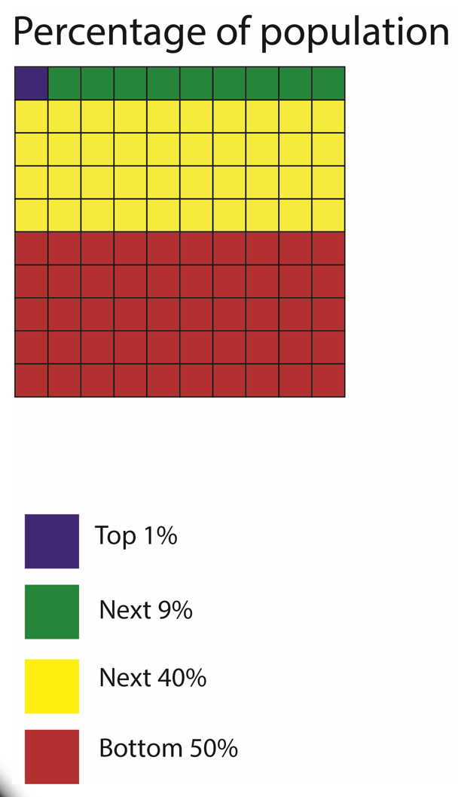
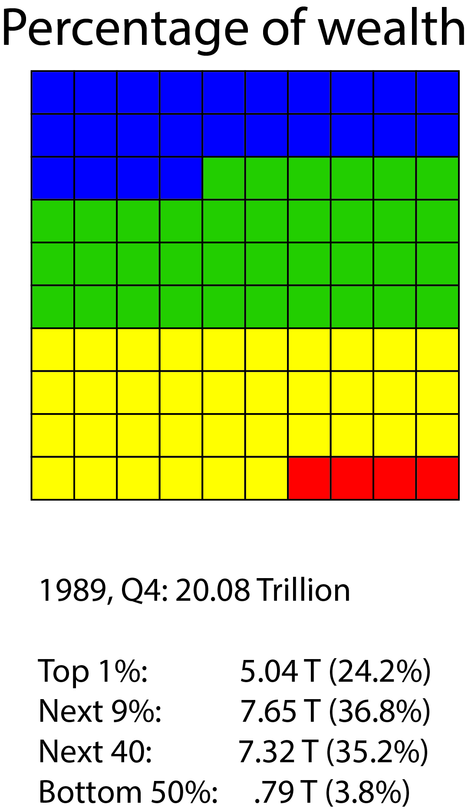
1989
2019

Slide 10
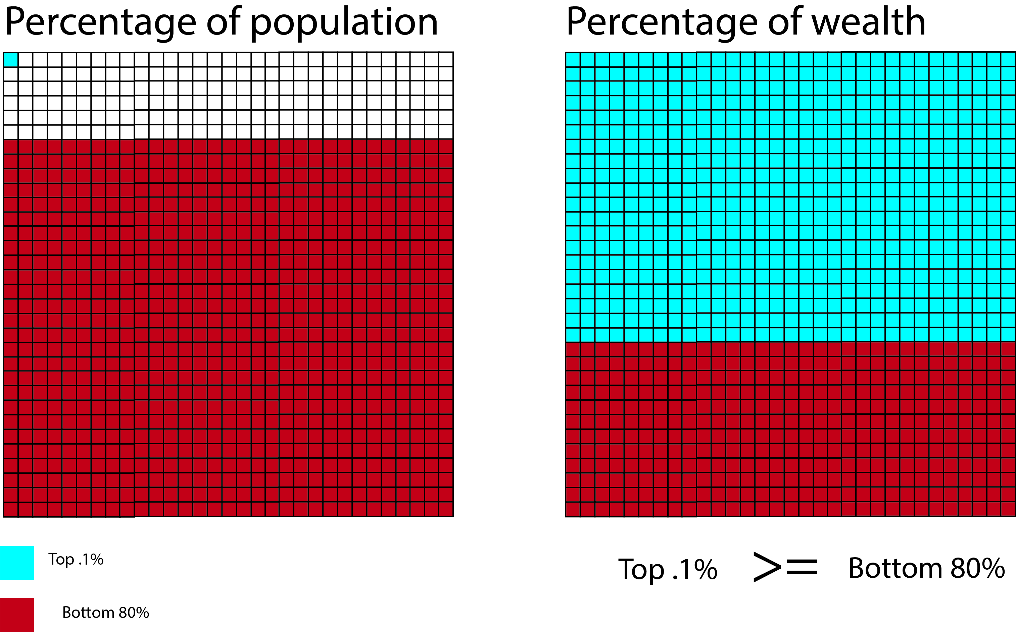

Slide 11
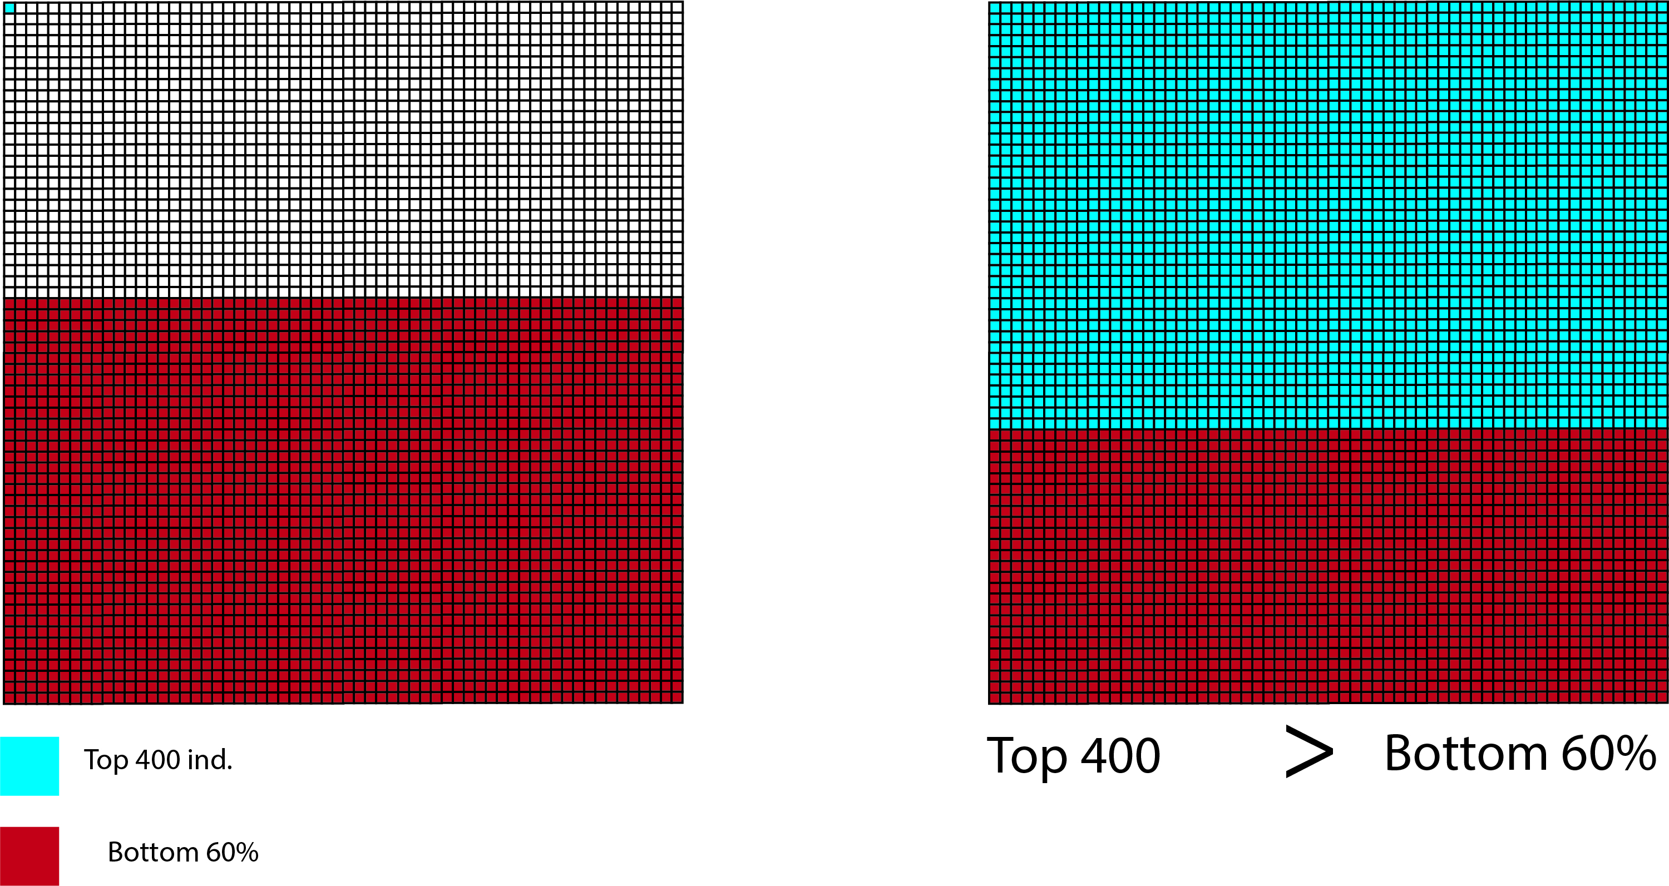

Slide 12
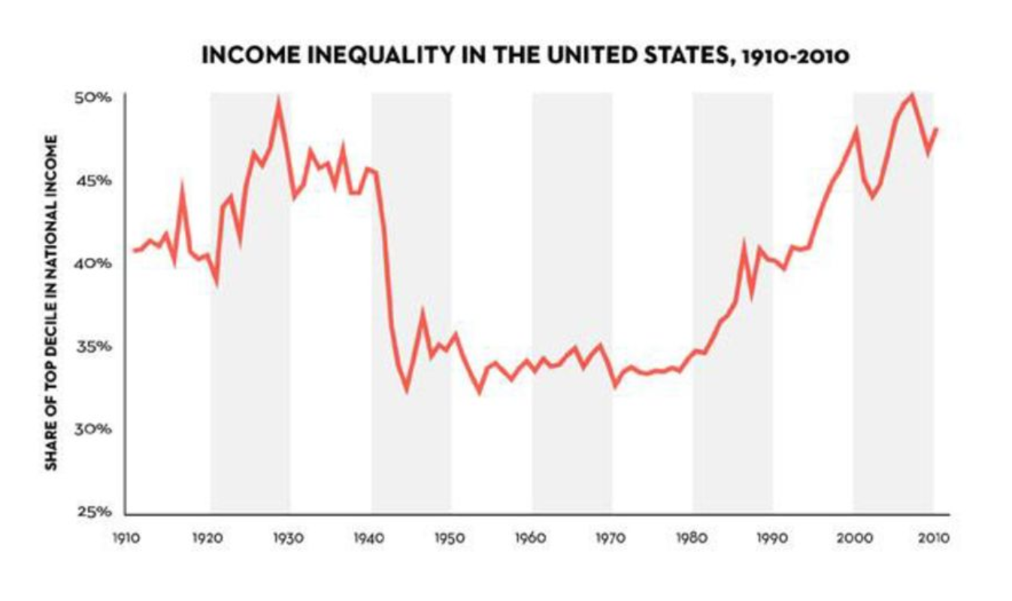

Slide 13
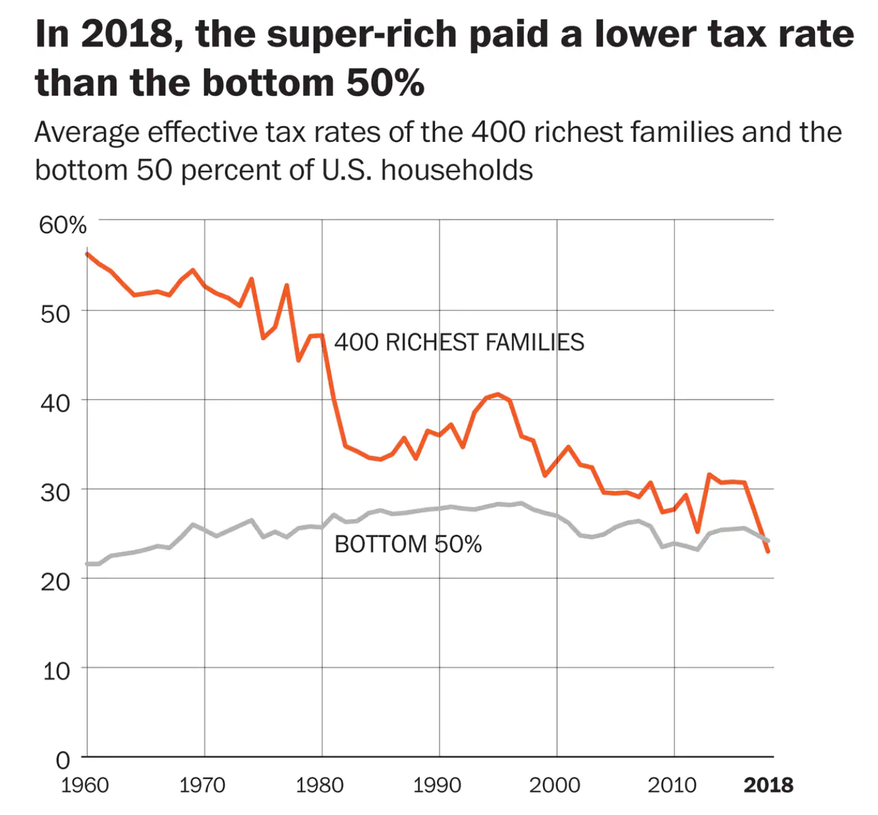
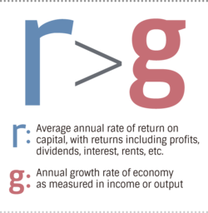

Slide 14
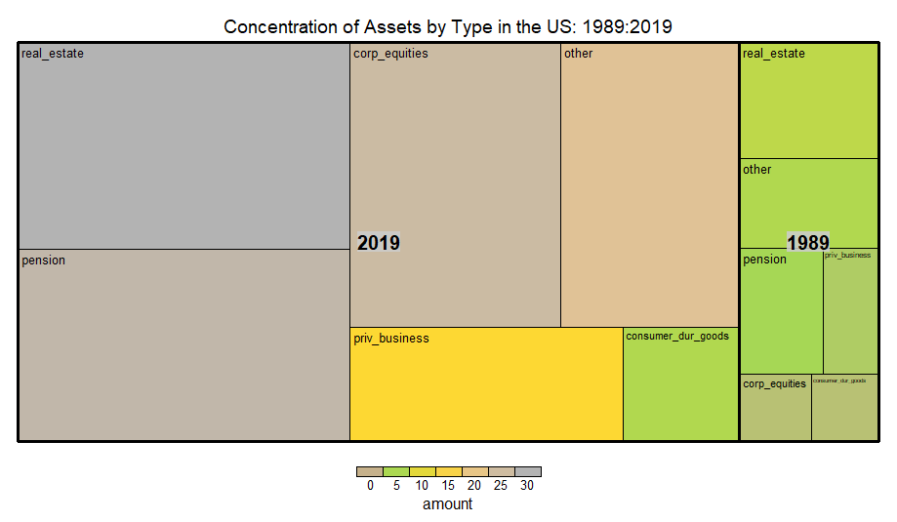

Slide 15
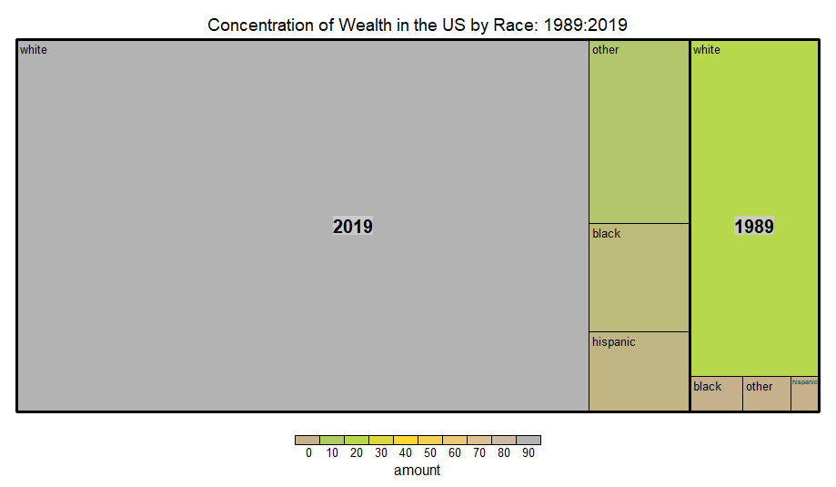

Slide 16
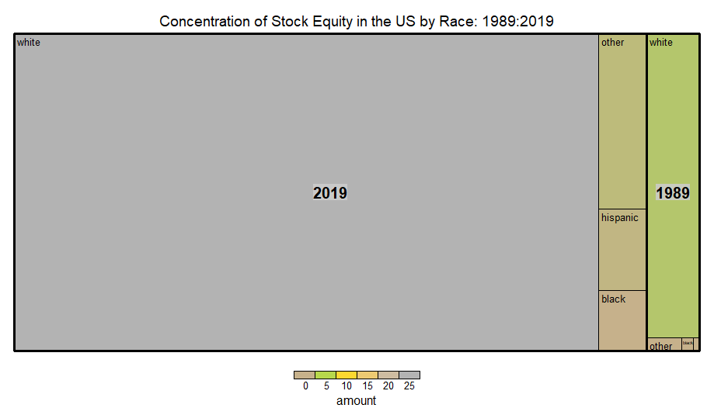

Slide 17
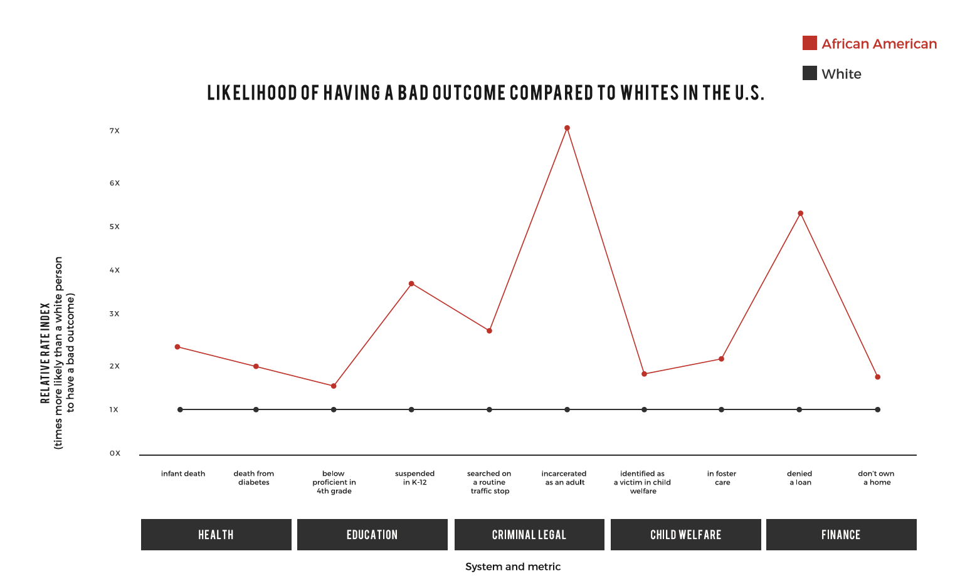

Slide 18
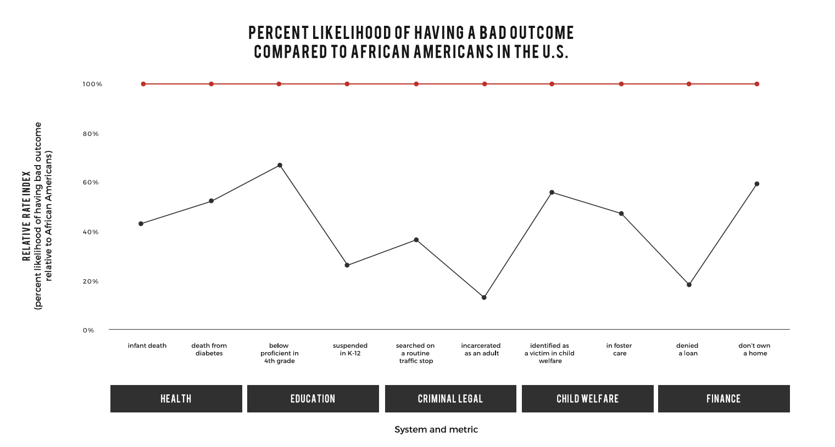

Slide 19
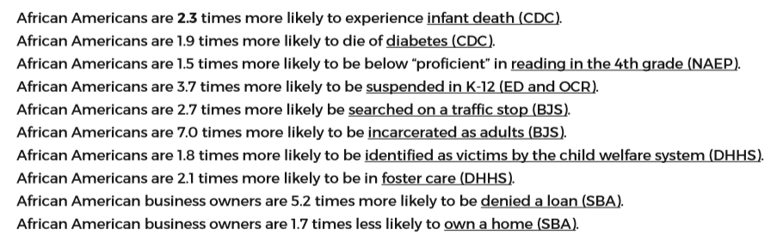

Slide 20
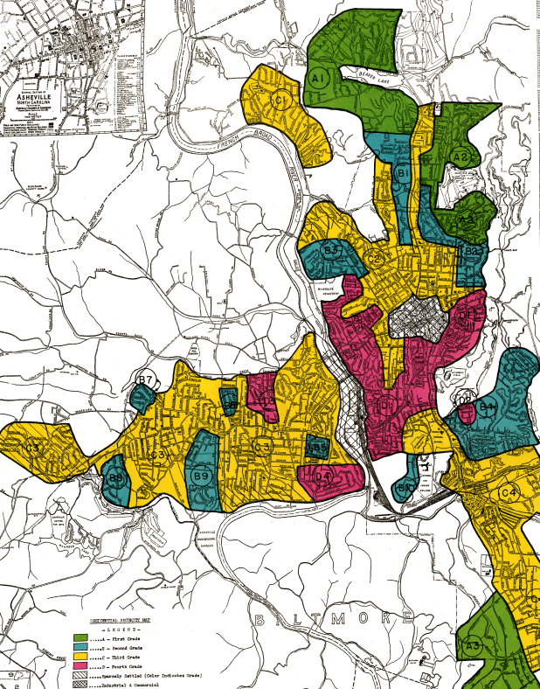
A home is one of the only assets in which the race of the owner affects the rate of return.

Slide 21
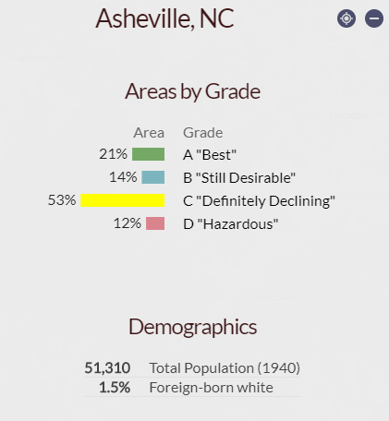
https://dsl.richmond.edu/panorama/redlining/#loc=12/35.583/-82.609&city=asheville-nc

Slide 22
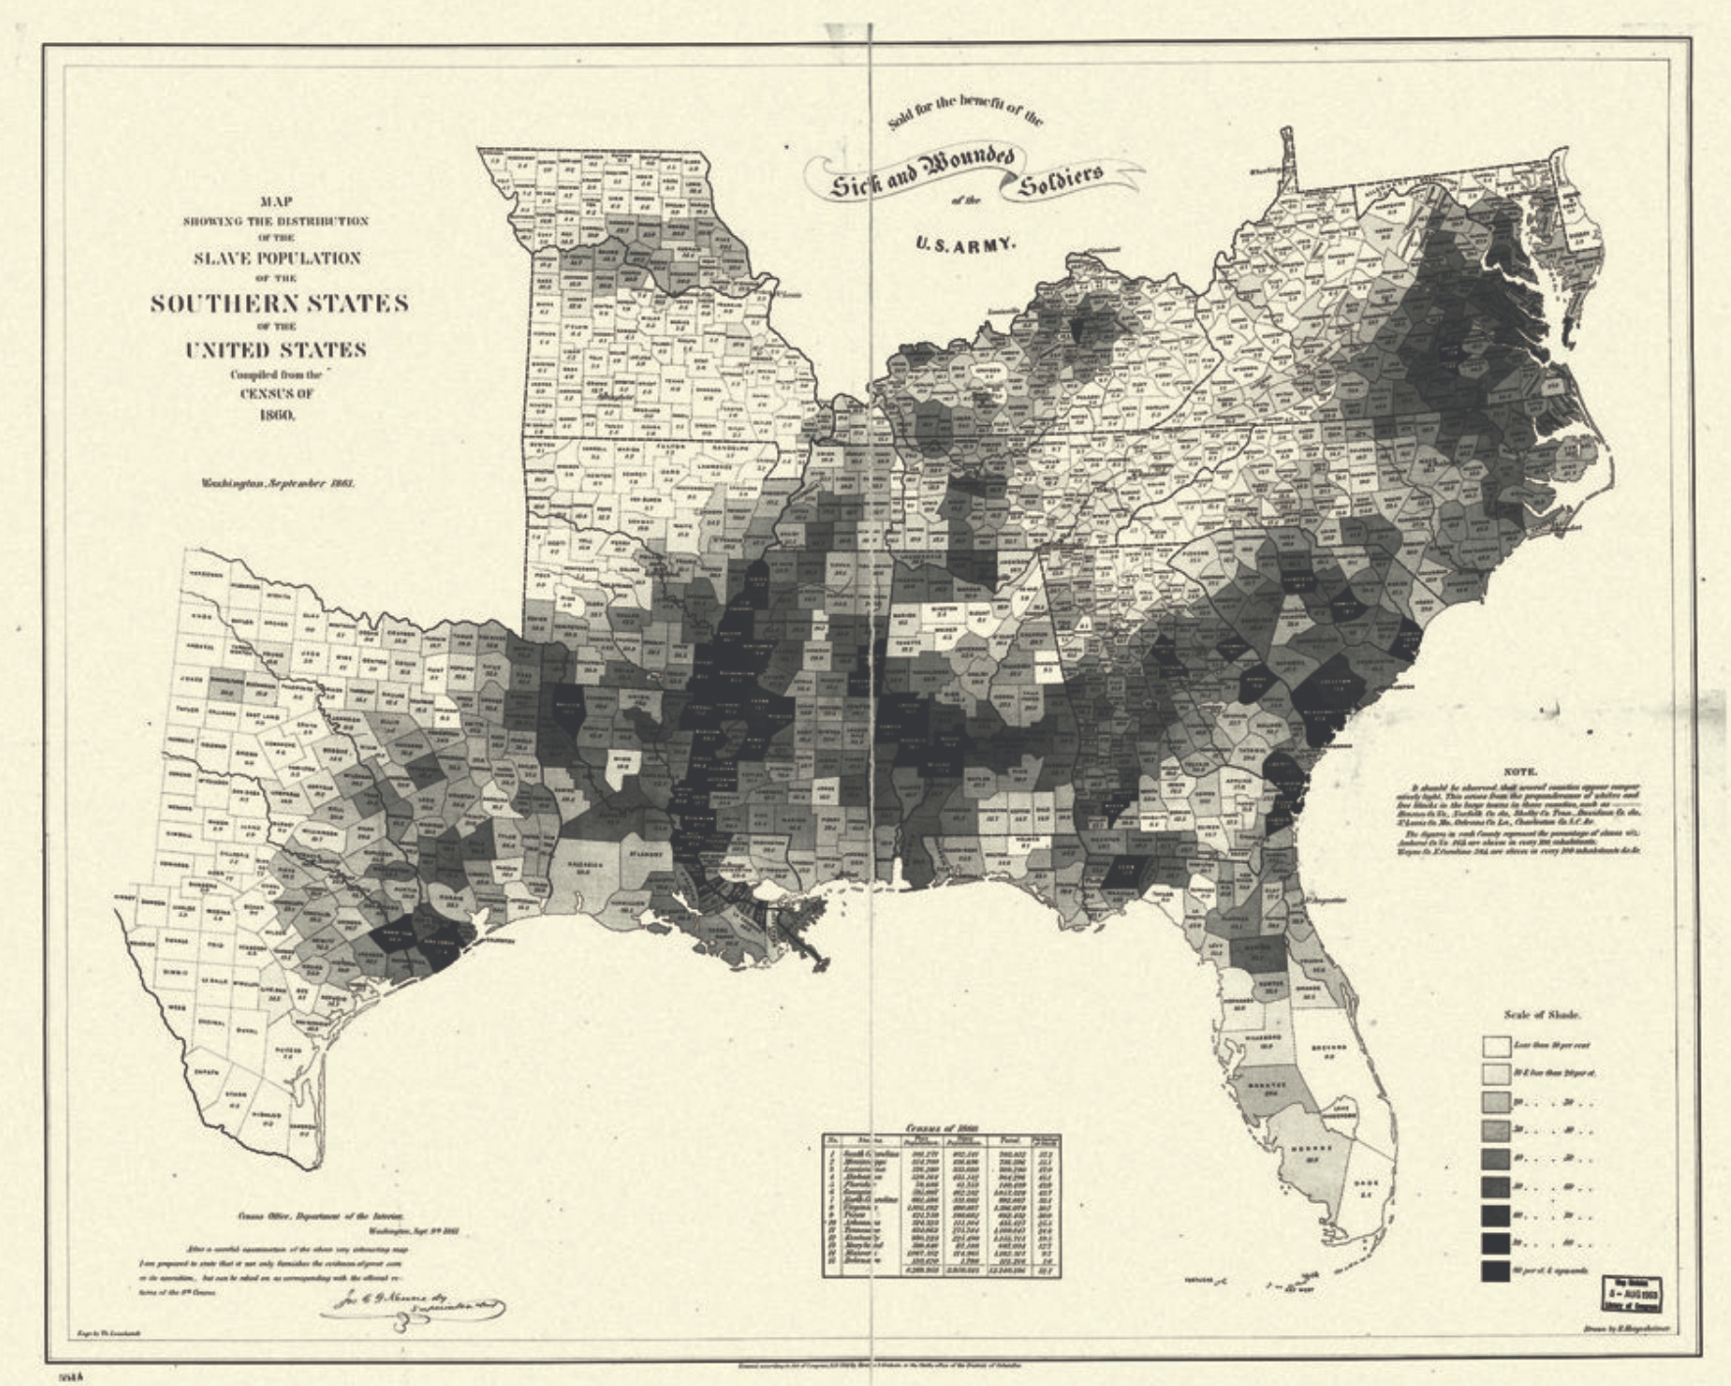
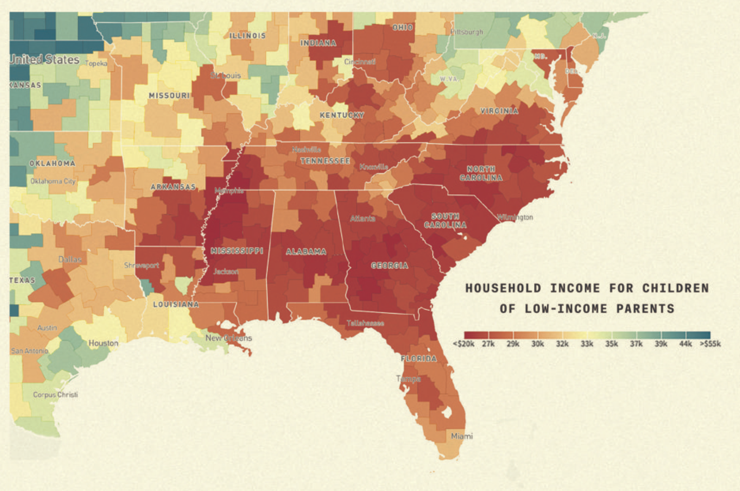

Slide 23
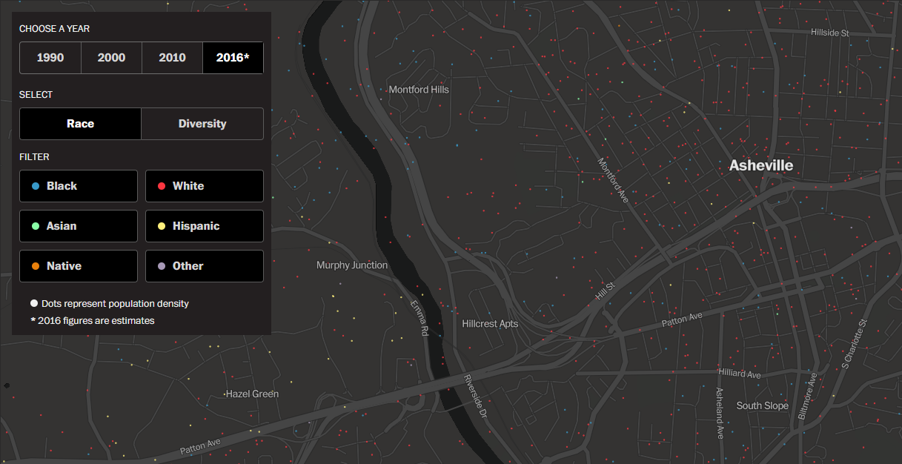
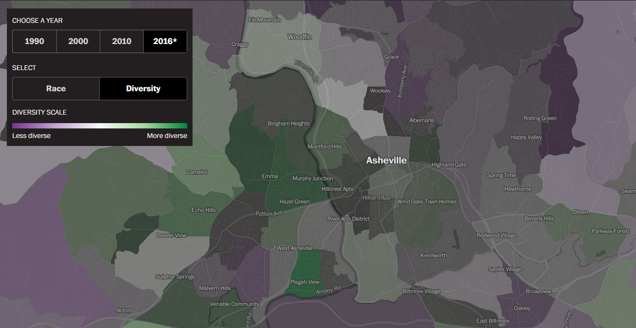
Measures of Segregation:
Dissimilarity & Entropy Indices
https://www.washingtonpost.com/graphics/2018/national/segregation-us-cities/

Slide 24
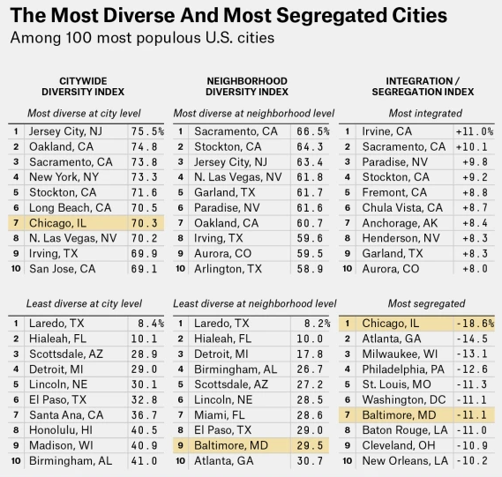
Measures of Segregation:
Citywide diversity index: For an average resident in the city, what % of people belong to a different racial group?
Neighborhood diversity index: For an average resident in the city, what % of the people in her neighborhood belong to a different racial group?
Integration-segregation index: The relationship between city & neighborhood segregation.

Slide 25
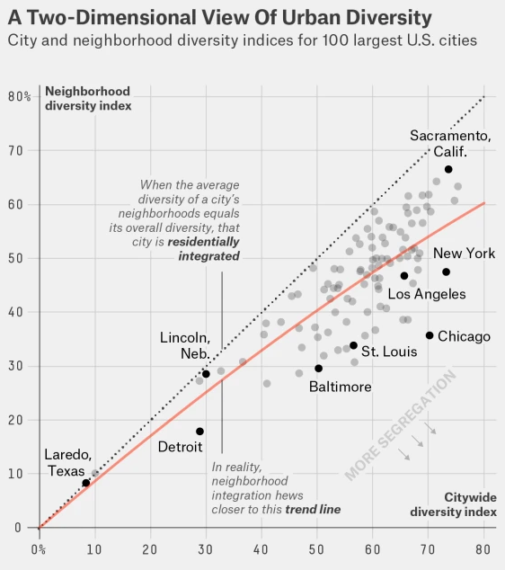
Of the top 100 U.S. cities by population, 35 are at least one-quarter black, and only 6 of those cities have positive integration scores.
Where does your city rank?
https://fivethirtyeight.com/features/the-most-diverse-cities-are-often-the-most-segregated/

Slide 26
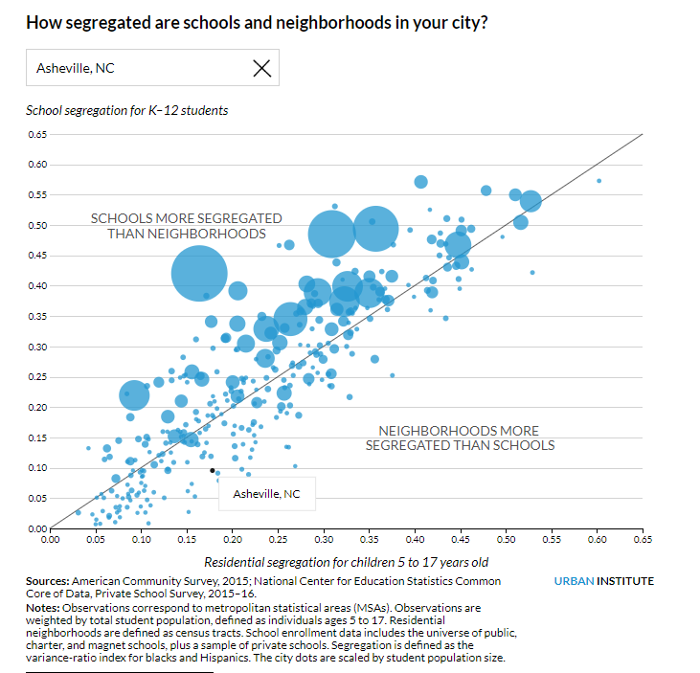
https://fivethirtyeight.com/features/the-most-diverse-cities-are-often-the-most-segregated/
https://www.urban.org/features/segregated-neighborhoods-segregated-schools

Slide 27
The Groundwater Approach

Slide 28
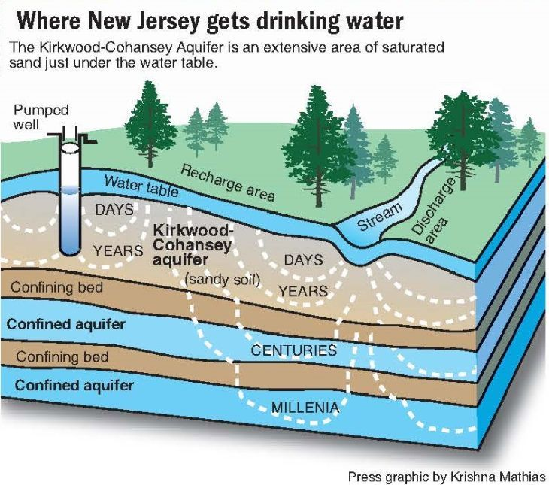
1.
TRANSITION HEADLINE
Let’s start with the first set of slides

Slide 29
Our groundwater metaphor is designed to help practitioners at all levels internalize the reality that we live in a racially structured society, and that is what causes racial inequity.
Racial inequity looks the same across systems.
Socioeconomic difference does not explain the racial inequity.
Inequities are caused by systems, regardless of people’s culture or behavior.
-Bayard Love & Deena Hayes-Greene, Racial Equity Institute

Slide 30
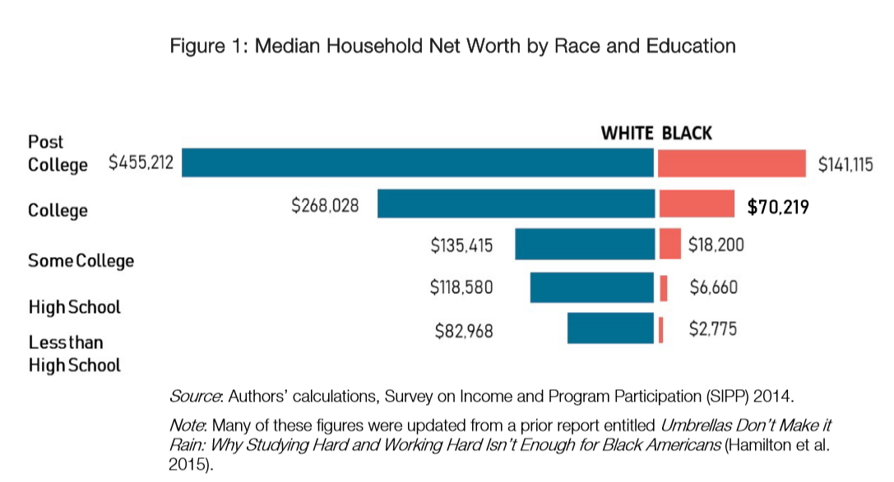
Myths about racial wealth gap
1
Greater educational attainment or more work effort on the part of blacks will close the racial wealth gap.
Darity, W., Hamilton, D., Paul, M., Aja, A., Price, A., Moore, A., Chiopris, C. What We Get Wrong About Closing the Racial Wealth Gap. (2018). Samuel DuBois Cook Center on Social Equity.

Slide 31
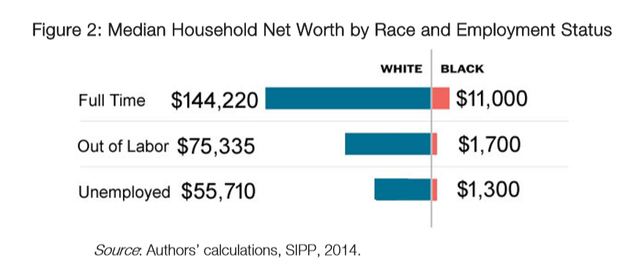
Myths about racial wealth gap
1
Greater educational attainment or more work effort on the part of blacks will close the racial wealth gap.

Slide 32
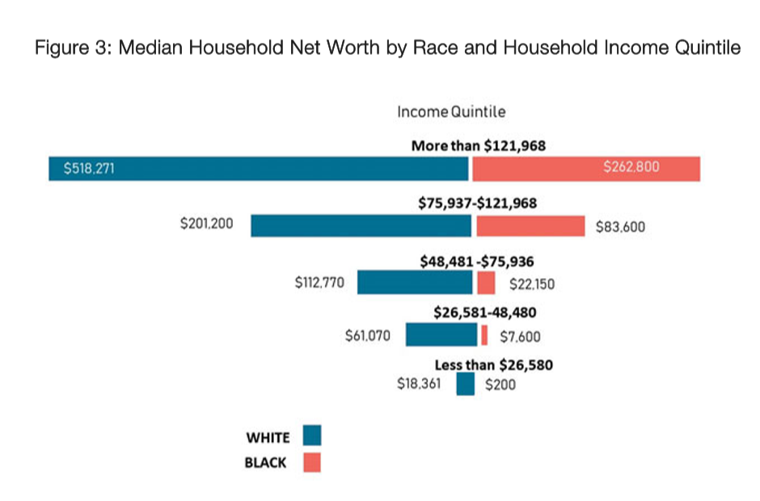
Myths about racial wealth gap
1
Greater educational attainment or more work effort on the part of blacks will close the racial wealth gap.

Slide 33
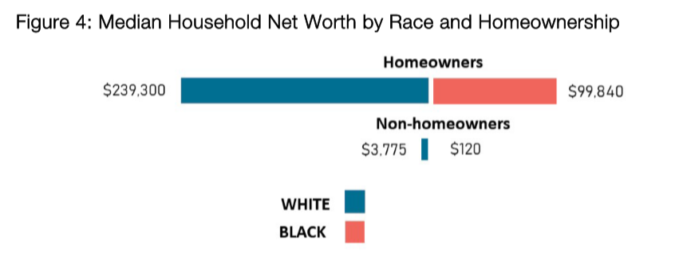
Myths about racial wealth gap
2
The racial homeownership gap is the “driver” of the racial wealth gap.

Slide 34
Myths about racial wealth gap
3
Buying and banking black will close the racial wealth gap.
4
Black people saving more will close the racial wealth gap.
5
Greater financial literacy will close the racial wealth gap.
6
Entrepreneurship will close the racial wealth gap.
7
Emulating successful minorities will close the racial wealth gap.
8
Improved “soft skills” and “personal responsibility” will close the racial wealth gap.

Slide 35

Myths about racial wealth gap
9
The growing numbers of black celebrities prove the racial wealth gap is closing.
10
Black family disorganization is a cause of the racial wealth gap.

Slide 36
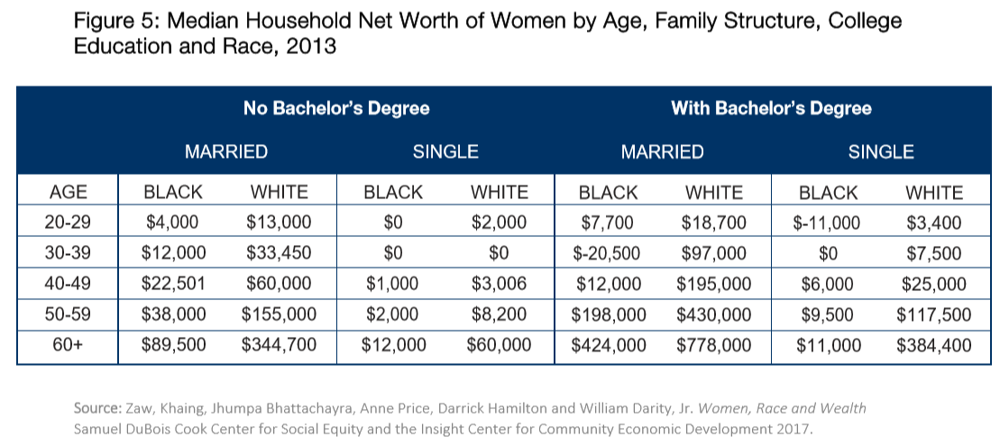
Myths about racial wealth gap
10
Black family disorganization is a cause of the racial wealth gap.

Slide 37
“A tangle of pathologies”
“Since the 1965 Moynihan report, The Negro Family: The Case for National Action, there is a conventional discourse that alleges self-detrimental behaviors stemming from legacies of discrimination and concentrations of poverty within the black community are the main cause for observed racial differences in quality and quantity of life.”
10
Black family disorganization is a cause of the racial wealth gap.

Slide 38
“A tangle of pathologies”
“Explanations that focus on behavior and so-called cultural factors also miss the point that retained wealth is a driving force for education, employment, and income outcomes. Rather than simply being shaped by family structure, wealth actually shapes family structure as well.”
10
Black family disorganization is a cause of the racial wealth gap.

Slide 39
What we’ll cover
Data trends related to structural racism.
Conceptualize and measure segregation.
Groundwater metaphor to explain “structural racism.”
Data on the myths about the racial wealth gap.
Slides & data are available at: github.com/jwesleyfurlong/wealthtrends

Slide 40
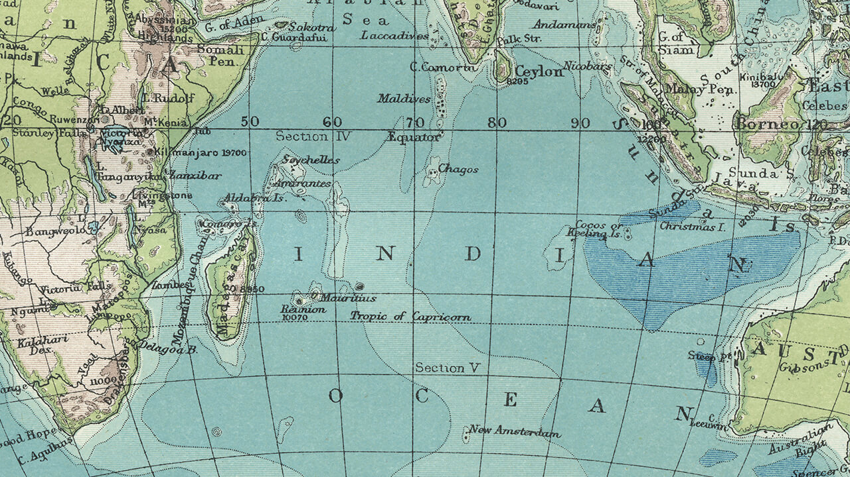

Place your screenshot here

Slide 41
Neddie Winters, GoodCities Board Member
Executive Director, Mission Mississippi

